Slide 1
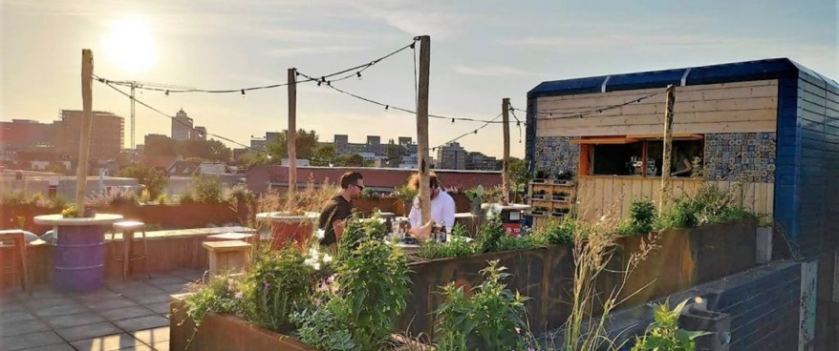
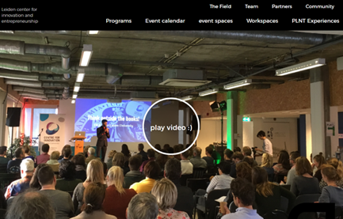
PLNT
Company Name
PLNT Centre for Innovation and Entrepreneurship in Leiden in The Netherlands
Date of Interview
September 2021 via Telephone
Contact Person
Bastiaan de Roo - Director
Email
CLICK
TO VIEW
frontoffice@plnt.nl
PLNT Leiden is committed to stimulate innovation and entrepreneurship in Leiden and region. The pre-incubation centre offers a divers mix of innovation and entrepreneurship programs, an active start-up-community, network-partners, flexible meeting and event-rooms, office-spaces and workplaces for innovative start-ups. Here, start-ups, based at the PLNT premises, are supported and take advantage of the knowledge and network for a flying start. PLNT also links talent between social partners and the business community, with the aim to find (new) solutions for existing and future SDG-challenges. These ideas and solutions may grow into new start-ups.
PLNT is actively supported by regional partners in the field of education (from university to VET-colleges), SME’s to the civil society and the local government.

Slide 2
ORGANISATION PROFILE
HOW MANY STAFF IS DIRECTLY EMPLOYED BY THE ORGANISATION?
IN ADDITION TO STAFF PRE COVID, HOW MANY PEOPLE ACCESS THE BUILDING ? (eg tenants, students, members of the public etc)
300
13 EMPLOYEES
MORE THAN PEOPLE DAILY
HOW LONG HAS THE ORGANISATION BEEN DRIVING A GREEN REVOLUTION/ INTRODUCED SDG POLICY’S OR ACTIONS?
WITHIN LAST 3 YEARS
WHAT SECTOR/S IS THE ORGANISATION ACTIVE IN?
HOW WOULD YOU DESCRIBE YOUR MAIN STAKEHOLDERS OR OCCUPANTS?
The organisation is active in all sectors. From health tot space, from agriculture to data-science.
Start-ups, Students and young professionals entrepreneurs who join PLNT as community member and/or tenant together with our stakeholders: educational partners, business partners, governments, SME’s and a mix of ngo’s.
GOOD PRACTICES
WHAT IS YOUR VISION AND STRATEGY RELATED TO SUSTAINABLE DEVELOPMENT/CLIMATE ACTIONS?
PLNT aims to make the Leiden region more innovative and enterprising. The transition to a clean, sustainable and resilient economy is on its way, together with several local and regional partners, in the field of education, research and entrepreneurship.
PLNT helps and stimulate people and organisations to develop ideas and solutions “from seed, to sprout to a healthy plant”. A diverse community of active PLNT-ers helps to grow together by learning from each other.
In cooperation with the partners, PLNT provides an inspirational environment with work and event places and several programs to help start-ups to work out their ideas. Some examples:
Start-up Play: develop an idea in a start-up concept
Venture Academy; a program for entrepreneurs that is committed to launch their start-up.

Slide 3
GOOD PRACTICES
WHAT ACTIONS DID YOU TAKE?
During the first couple of years, PLNT organised more than 800 events and facilitated more than 1400 ideas to grow from seed.
PLNT used its network to collect experiences from identical centres
PLNT had contacts from the local and national government to get support.
PLNT developed a marketing plan to promote itself.
WHICH PARTNERS AND STAKEHOLDERS WERE INVOLVED?
The community of PLNT has several partners in the field of education, research and businesses and is still growing. More information See: https://plnt.nl/partners/
DID YOU RECEIVE ANY KIND OF TRAINING OR SUPPORT REGARDING YOUR ACTIONS?
We did not receive concrete training. The team consists of professionals with backgrounds in supporting SME’s, local government, higher education, start-up-centres, entrainment-industry and communication. By combining challenges, expertise and network in a start-up way by doing, showing and testing supported by partners the centres works as a start-up itself.
WHICH RESULTS DID YOU ACHIEVE ALREADY?
Some of our start-ups have developed serious solutions for challenges in the field of energy, climate-change, pharma, agriculture and health and are growing their business.
The centre developed a circular multi-functional roof garden as well as a circular pavilion over the last 2 years where challenges can meet solutions.
The centre has become a hotspot and podium for the growing quadruple helix of industry, academia and government and civil society.
WHAT ARE YOUR FUTURE PLANS AND NEXT STEPS?
To expand fertile ground on which our community of students and start-ups can grow and meet the challenges of our partners and network. Extra attention will go to the chain-concept of educate, stimulate, innovate and execute. Our centre and community are part of the larger switch in the chain of solutions for the challenges of today and tomorrow. We can only be sustainable, when the complete chain is.

Slide 4
RECOMMENDATIONS
WHAT KIND OF HELP AND TOOLS DO YOU NEED TO REALISE YOUR FUTURE GOALS?
WHAT ARE YOUR MOST IMPORTANT TIPS & ADVICE TO GIVE TO OTHER ORGANISATIONS TO IMPLEMENT SDG WITHIN THEIR BUSINESS?
Budget to further develop programs for different SDG’s challenges
Developing good contacts with other sustainable enterprise centres in The Netherlands, for exchanging ideas and for cooperation.
Partners for developing more sustainable concepts.
Good promotion and marketing.
Invest and ask your networks what they can do,
Experiment, show and tell
Develop a sustainable chain-concept with the quadruple partners
Invest in a divers team of professionals from different fields.
WHAT SUSTAINABLE GOALS WOULD YOU LIKE TO IMPLEMENT IN THE FUTURE?
01
Sustainable Infrastructure/Buildings – SDG11 Sustainable cities and Communities and SDG13 Climate action:
Next 6 months and further, depending on financial possibilities
Energy and Resource Efficiency – SDG 7 Affordable and clean energy and SDG12 Responsible consumption and production:
02
Next 12 months and further, depending on financial possibilities.
Sustainable Eco-systems and Collective Action – SDG4 Quality Education, SDG12 Responsible consumption and production and SDG17 Partnership for the Goals:
03
Next 12 months, depending on financial possibilities.
Digital Technology for Sustainable Enterprise Centres – SDG8 Decent work and Economic Growth and SDG13 Climate action:
04
Next 6 months. Important topics are Digital security, AI and data protection.
05
Sustainable Futures for Enterprise Centres – SDG 9 -Industrial innovation & infrastructure and SDG17 Partnership for the Goals:
Next 1-3 years and further, depending on financial possibilities.

