Slide 1
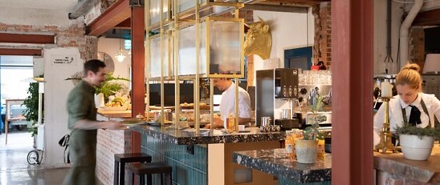
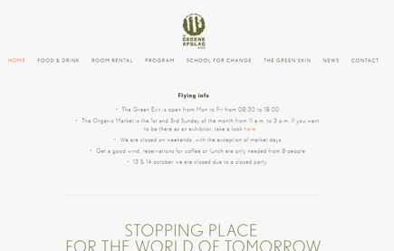
DE GROENE AFSLAG
(The Green Exit)
Company Name
The Green Exit in Laren in The Netherlands
Date of Interview
July 2021
Contact Person
Lucas Mol - Director
Email
CLICK
TO VIEW
doejeding@degroeneafslag.nl
‘De Groene Afslag’ (The Green Exit) is an Impact HUB for the World of Tomorrow. A hangout where sustainable frontrunners and change agents can meet and inspire each other. A place to eat and drink, work, meet, learn, celebrate and have fun. De Groene Afslag is located in an old prison and refugee centre along highway A1 in Laren between Amsterdam and Apeldoorn in The Netherlands.
Several tenants ‘are living’ at the Groene Afslag. Other tenants use the flexible workplaces only for the time they need it. The tenants have several backgrounds and services but are all committed to a green and sustainable future and are investing in the Sustainable Development Goals.
Main activities:
Renting out different kind of workplaces
Event location with meeting rooms of different sizes
Café and restaurant with vegetarian and vegan food
Sustainable events like presentations, markets, etc.
School for Change
De Groene Afslag

Slide 2
ORGANISATION PROFILE
HOW MANY STAFF IS DIRECTLY EMPLOYED BY THE ORGANISATION?
IN ADDITION TO STAFF PRE COVID, HOW MANY PEOPLE ACCESS THE BUILDING ? (eg tenants, students, members of the public etc)
300
8 EMPLOYEES
MORE THAN PEOPLE DAILY
HOW LONG HAS THE ORGANISATION BEEN DRIVING A GREEN REVOLUTION/ INTRODUCED SDG POLICY’S OR ACTIONS?
WITHIN LAST 2 YEARS
WHAT SECTOR/S IS THE ORGANISATION ACTIVE IN?
HOW WOULD YOU DESCRIBE YOUR MAIN STAKEHOLDERS OR OCCUPANTS?
Sustainability & Greening Events/Training.
Tenants start-ups and scale-ups
GOOD PRACTICES
WHAT IS YOUR VISION AND STRATEGY RELATED TO SUSTAINABLE DEVELOPMENT/CLIMATE ACTIONS?
De Groene Afslag is the meeting place for the change agents of the new green and sustainable society. A common playground for people who realize that we will have to change a number of things in our lives, one way or another. The Groene Afslag is the ‘village pump’ where those change agents meet. Their mission: “We show that the world can become greener and you can too”. This is the greater purpose they believe in and that underlies everything they say and do.
Their approach is to keep it simple and on a low profile. The world is already complicated enough. Sustainability needs to be closer to ourselves and not abstract and far away in the media. It also needs more action today and sometime less in the future.

Slide 3
GOOD PRACTICES
WHAT ACTIONS DID YOU TAKE?
The entrance of the building has been changed by adding a container.
The interior of the building and rooms is realised by artists with used and cheap circular materials and art, based on waste. For example, the ceiling is decorated with chairs and the wash basins are now used as planters. The interior is a sustainable exhibition by itself.
Creating a café and bar with a vegetarian/vegan menu. “Within our café and restaurant there is always something green between your teeth.“
The building is also a shelter for big old plants.
Creating different kinds of event room with a sustainable or green theme. For example, a room of change or the board room with a complete interior of cardboard or a room with old cinema seats. See: https://degroeneafslag.nl/kamersenzalen
Introduction of The school for Change, with a program of master courses and masterclasses regarding System transition, Economics, Branding, Ecology and Finance: https://schoolforchange.nl/
Organising different kinds of events to inspire people for their own transition from sustainable thinking to going green. https://degroeneafslag.nl/programma
WHICH PARTNERS AND STAKEHOLDERS WERE INVOLVED?
Additional to the tenants and artists, the Green Exit has several partners which supports the initiatives, like:
The DOEN foundation supports initiatives in the field of green and inclusive economy,
Council of 100 people who invested 5K euro or more,
Supporters who donate in kind,
Volunteers invest their time and knowledge.
DID YOU RECEIVE ANY KIND OF TRAINING OR SUPPORT REGARDING YOUR ACTIONS?
We got support from our own network, but no training. We are a community of practice, working and learning together with the same ambition.
WHICH RESULTS DID YOU ACHIEVE ALREADY?
Together with our stakeholders and tenants we have reached many people during the last couple of years and inspired them with our environment and rooms, events and our community.
As a result of COVID we had to cancel the events for a couple of months. No figures available. See our first birthday party: https://www.youtube.com/watch?v=yGejJC9o-jA&t=20s and our latest news https://degroeneafslag.nl/nieuwtjes
WHAT ARE YOUR FUTURE PLANS AND NEXT STEPS?
We proceed our work and are preparing a new location at an old military complex nearby.

Slide 4
RECOMMENDATIONS
WHAT KIND OF HELP AND TOOLS DO YOU NEED TO REALISE YOUR FUTURE GOALS?
WHAT ARE YOUR MOST IMPORTANT TIPS & ADVICE TO GIVE TO OTHER ORGANISATIONS TO IMPLEMENT SDG WITHIN THEIR BUSINESS?
Inspiring people who want to donate their knowledge and time,
Inspiring people with their simple and smart ideas,
Inspiring waste materials.
Keep it simple. The world is complicated enough.
Don’t judge others but try to inspire them to think about sustainability and renew their actions.
Give room to innovative young entrepreneurs
Facilitate young entrepreneurs and use their ideas for renewal and transitions needed to build up a sustainable, climate neutral society.
WHAT SUSTAINABLE GOALS WOULD YOU LIKE TO IMPLEMENT IN THE FUTURE?
01
Sustainable Infrastructure/Buildings – SDG11 Sustainable cities and Communities and SDG13 Climate action:
Next 6 months and further
Energy and Resource Efficiency – SDG 7 Affordable and clean energy and SDG12 Responsible consumption and production:
02
Next 6 months and further
Sustainable Eco-systems and Collective Action – SDG4 Quality Education, SDG12 Responsible consumption and production and SDG17 Partnership for the Goals:
03
Next 6 months and further
Digital Technology for Sustainable Enterprise Centres – SDG8 Decent work and Economic Growth and SDG13 Climate action:
04
TBC
05
Sustainable Futures for Enterprise Centres – SDG 9 -Industrial innovation & infrastructure and SDG17 Partnership for the Goals:
Next 6 months and further

